Slide 1
A LOW-COST INFRARED VIDEO SYSTEM FOR REMOTE BAT COLONY MONITORING, INCLUDING RECORDS OF LITTLE BROWN BAT SYSTEMATIC SEASONAL VARIATION
Larry Gorham, Community Scientist
James Fischer, WMCC Wildlife Biologist
Dr. Devaughn Fraser, CT DEEP Wildlife Biologist
Daniela Ramirez, Student Volunteer
Notes:
Good morning
I’m Larry Gorham and I’ll be discussing our low-cost IR recording system for the little brown bat maternal colony at the White Memorial Conservation Center in Litchfield, CT.
I’m a retired engineer with a passion for bats but I’m not an expert so please bare with me on the biology. I want to thank two wildlife biologists for support and guidance on this project. James Fischer at White Memorial and Dr. Devaugh Fraser at Connecticut DEEP.
I also had help counting bats from a highly motivated high school student, Daniela Ramirez.

Slide 2
How do we continuously video bats in the field?
There is
No WiFi
No Internet
No electricity
We use solar power and a battery
Illuminate the bat houses with infrared light
Record bat videos onto a flash drive
Collect the data every few days
Notes:
How do we continuously video bats in the field? Where There is No WiFi, No Internet, No power.
We use solar power and a battery to Illuminate the bat houses with infrared uSD card.
Collect the data every few days by switching cards.

Slide 3
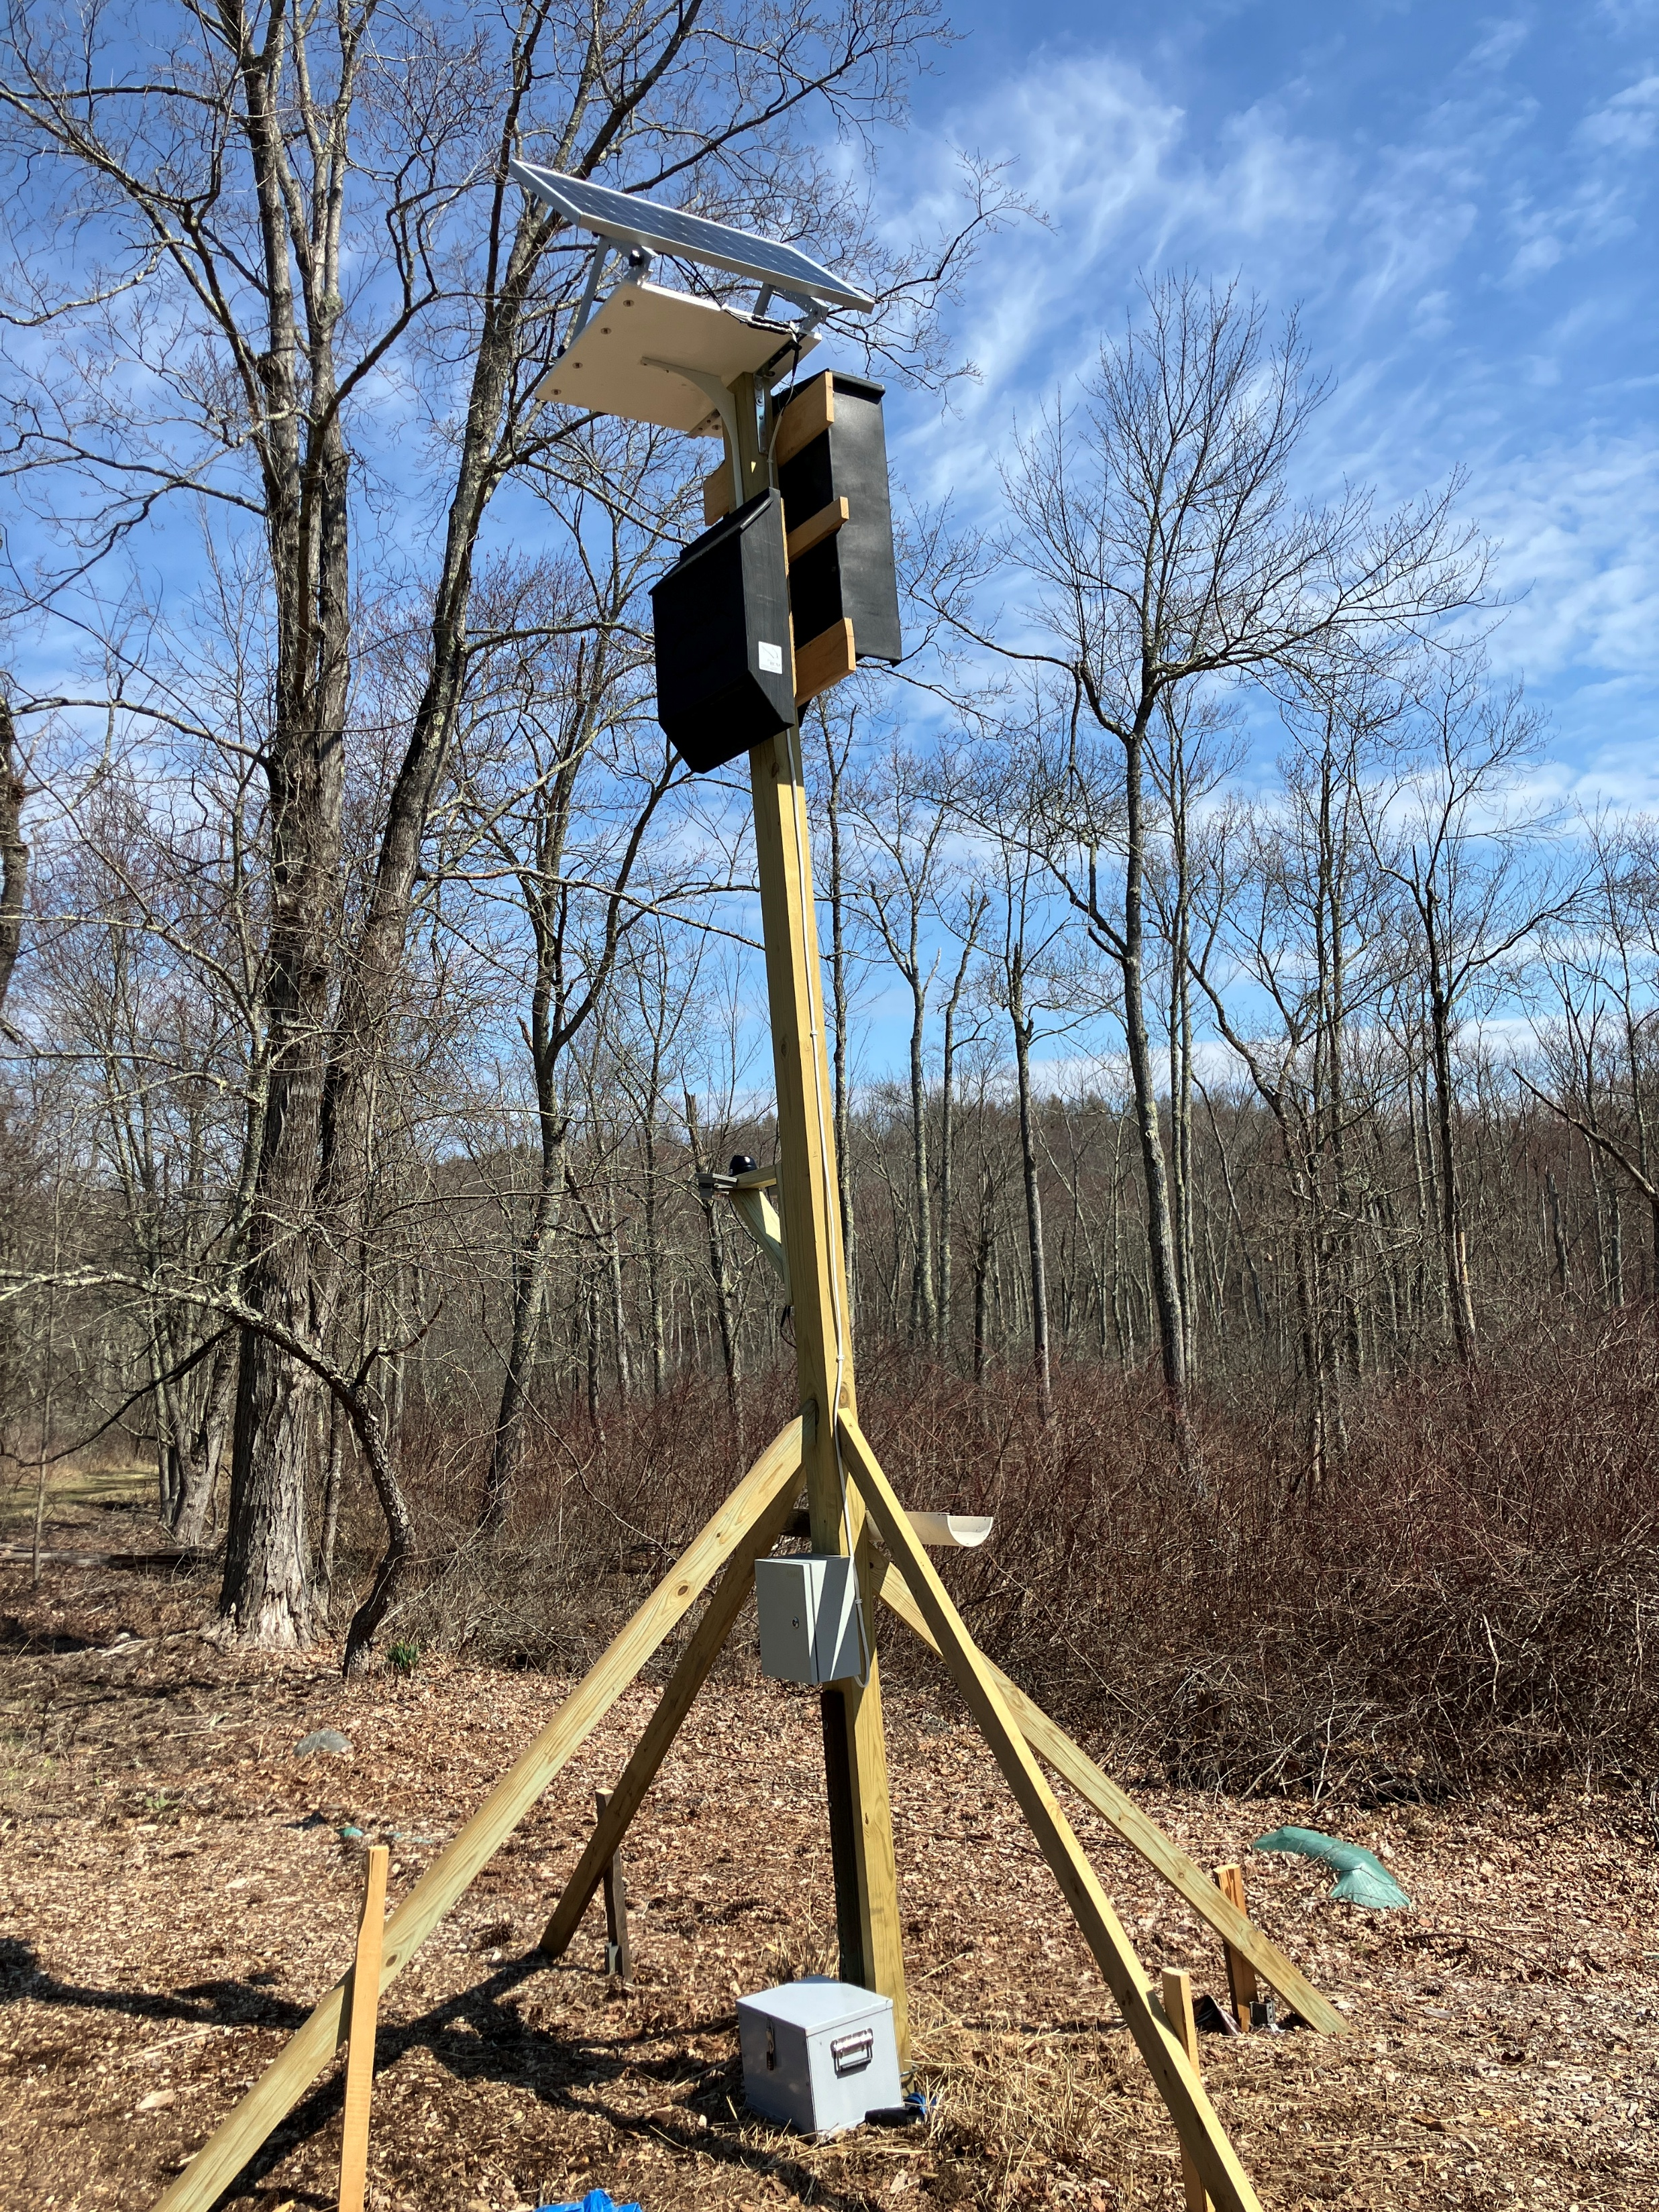
Colony With
Recording System
Notes:
This is the complete system, shown here securely mounted on an existing little brown bat maternal colony residing in those two Bat Bunker bat houses
Battery box on the ground securely locked to the pole.
Control panel shoulder high.
Camera/IR lights about 8 feet.
And a 100 watt solar panel on top.

Slide 4
Main Features Bat Recorder
Automatic
Remote and secure
Powerful IR lights (850nm)
Solar and battery powered
All software is public domain
Inexpensive < $700
Notes:
The main features of this system include : It is designed to be automatic and run the entire season. It can be installed remotely and be relatively secure. It uses IR lights for illumination. It is solar and battery powered. All software is public domain. And our first system that was used to record last year was 700 dollars.

Slide 5
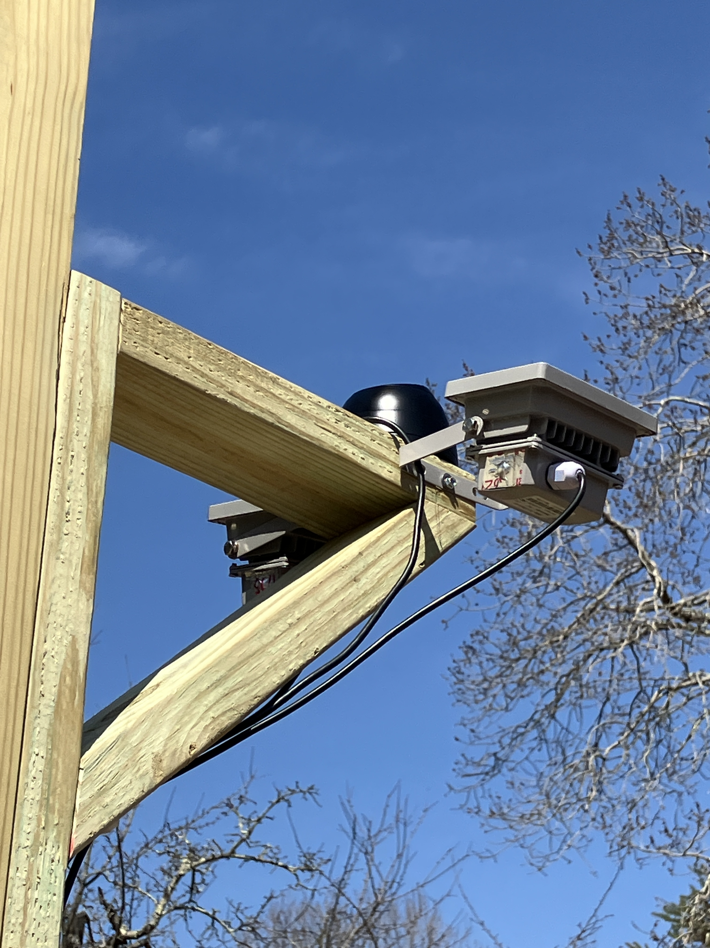
IR Camera & Lights
Notes:
This is a closeup of the camera and IR lights
The camera is a very common 40 dollar security camera with a couple of minor modifications. It will do hi-res but we recorded in low-res to reduce the post processing load.
The two lights require 6 watts each and produce 850 nm IR which is invisible to bats.

Slide 6
Remote, Solar - battery powered IR Video recording system - Approximate Cost
Camera - ELP-USBGS5MP01-V100, Global Shutter IR (Amazon) 167.00 USD
Waterproof capsule from SVPRO USB camera (Amazon) 40.00
IR Light 940nm UQISOVI (Amazon) 26.00 x 2 52.00
Computer - Raspberry Pi 4B - 2GByte (Amazon) 63.00
Smart Cooling Fan - SeenGreat PWM 33.00
Power Manager, Real Time Clock - Witty Pi 4, UUGear 58.00
USB SD drive - various 10.00
Solar Collector 100 Watts 160.00
Solar Panel Mount, Regony Home Depot 30.00
Battery, lead acid 150.00
Solar Battery controller, LiTime 20 Amp PWM Amazon 43.00
Secure System Enclosure, Steel, Vevor.com 53.00
Marine plywood platform 100.00
Hardware, electrical wire, 150.00
Tax, Shipping 100.00
Total 1209.00 USD
Notes:
The total cost of this system from last year was about 700 USD and that’s now gone up to about 1000 dollars. The list shown here uses a much better camera and tops out at about 1200 dollars. Oddly enough one of the expensive items is the marine grade plywood mount for the solar panel. That’s not necessary if a side pole mount can be used which cost about ¼ of what this mount costs. Depending on the sunlight probability a less expensive 50 watt solar panel would also work.

Slide 7
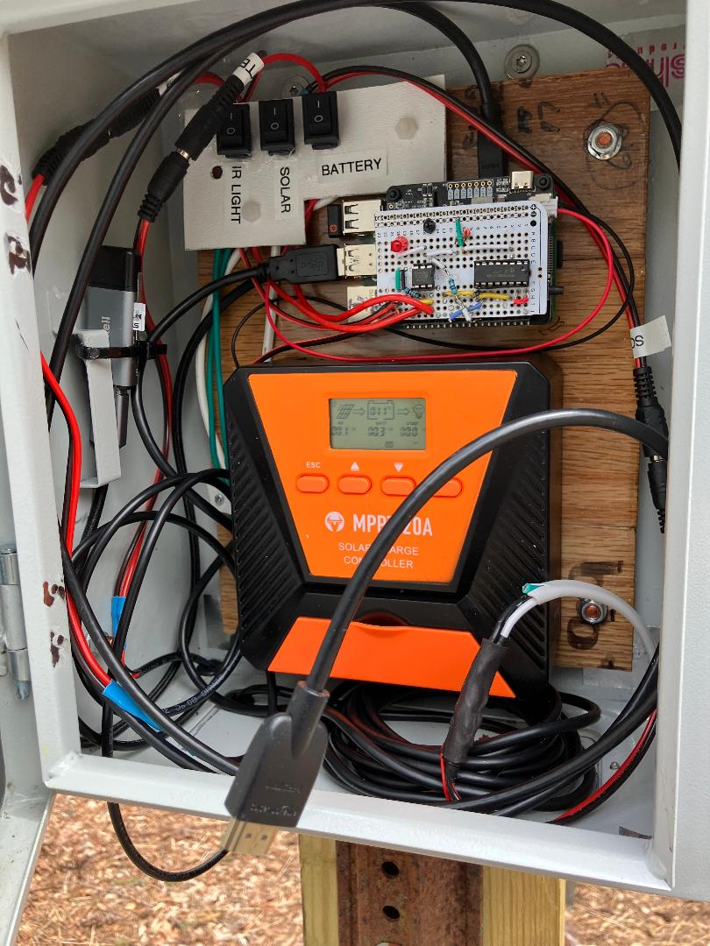
Control Panel
Notes:
This is the control panel with switches at the top, computer stack below and the orange solar controller at the bottom. The switches just isolate components, the computer stack controls everything except battery charging which is done by the solar controller. The controller is a little more expensive MPPT type which provides much more efficient battery charging. The wire shown hanging out the door is an HDMI connection for a monitor so program updates can be done in the field. The panel has a locking door and is securely attached to the pole

Slide 8
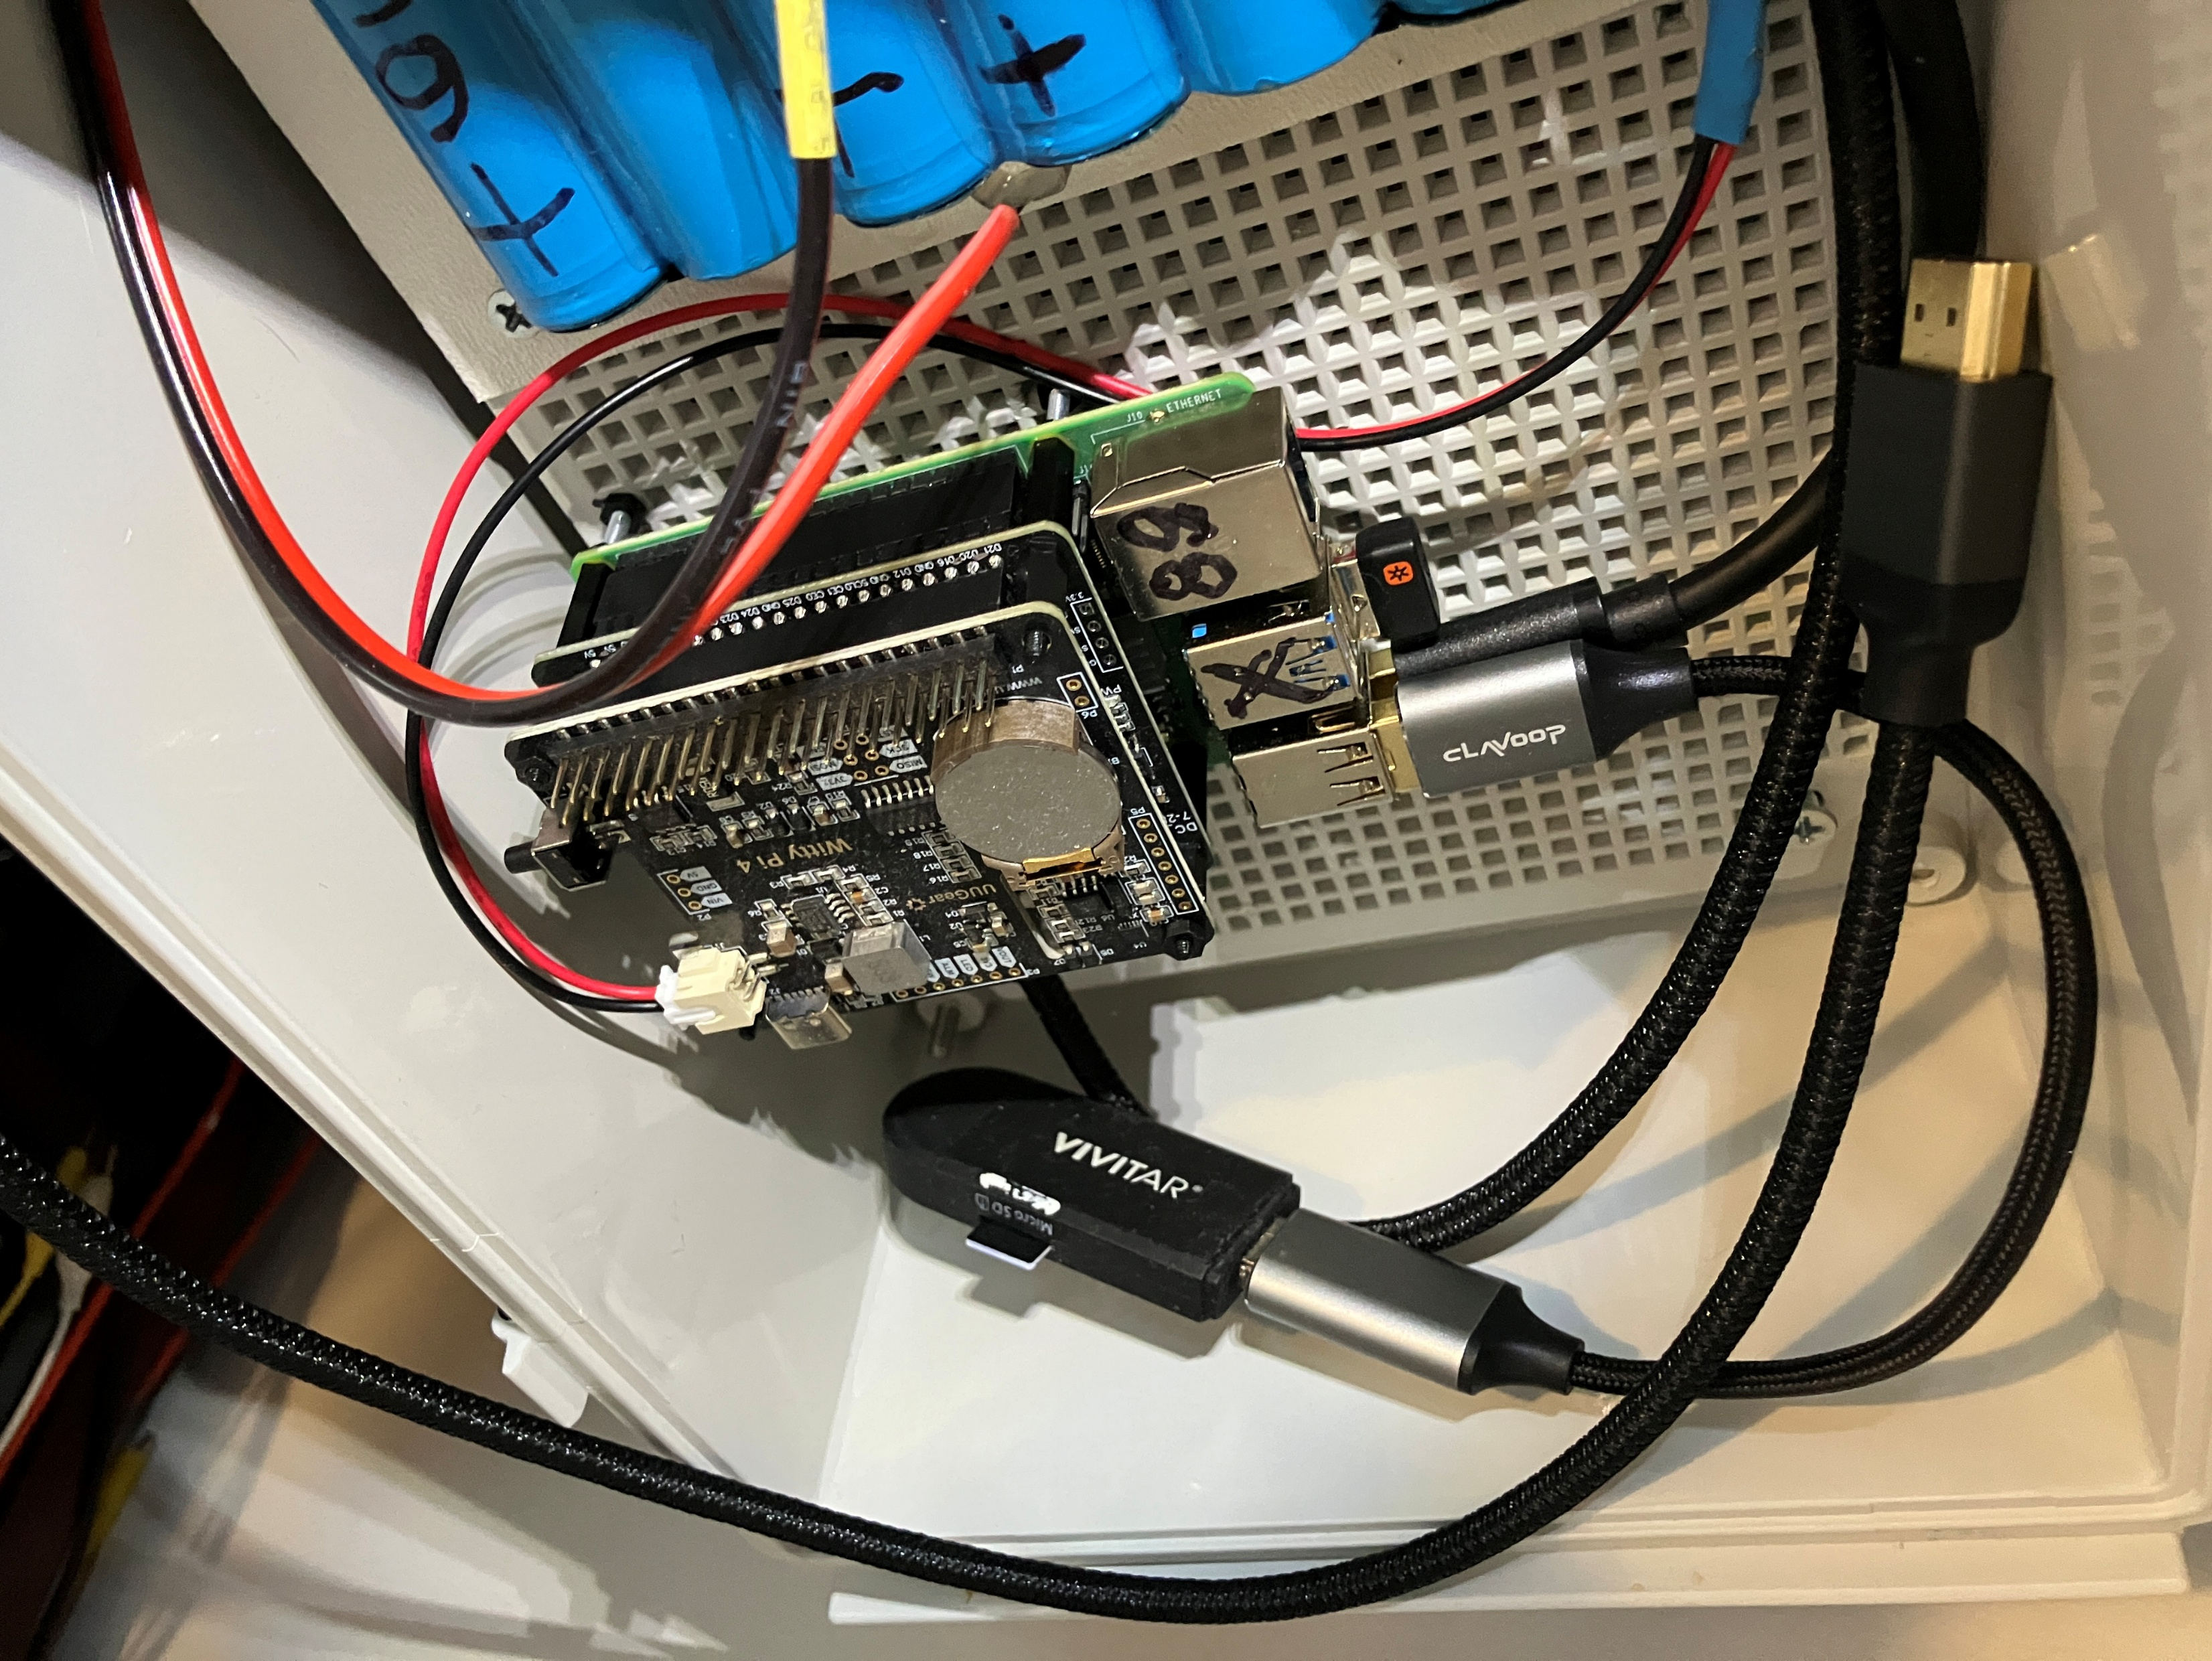
Compute Stack
Notes:
The compute stack starts with a Raspberri Pi 4b on bottom with a fan module in the middle and a WittyPi4 power controller on top. The Raspberry PI starts recording video when it is booted up but that requires about 20 watts of power so it must be shut down when not recording to save the battery. The WittyPI starts and stops the Raspberry Pi according to it’s stored schedule. It only uses ¼ watts of power so the battery lasts much longer. The WittyPi always runs in the background, contains the schedule and start times for every record event in the entire active season.

Slide 9
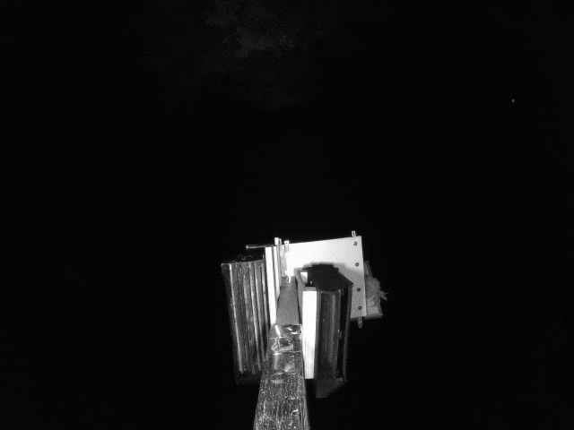
Bat Egressing
Notes:
This is a 30 sec video recorded at the maternal colony and looking at the bottom egress openings of the two bat houses. It shows a bat emerge from inside the larger bat house to “light sample” for a brief period. Then, unlike some Gen Zer’s it launches into flight. The action is slowed by a factor of 10 for this demonstration.

Slide 10
How To Count Bats
We could physically watch the bat houses for two hours with two clickers
But that’s really difficult to get accurate results.
Ultrasonic counting is not accurate
Instead we video the bats in infrared light
We could view the two hour video or
Use a computer to scan the video and help us count bats
ThruTracker by Dr. Aaron Corcoran of UC Colorado Springs
Notes:
How do we count bats?
We could physically watch the bat houses for two hours with clickers but that is really difficult to get accurate results. We could record the bats ultrasonically but that method has been shown to have a wide range of counting errors.
Instead, we video the bats in infrared light.
Then, we could view the two-hour video or
Use a computer program to scan the video and help us count bats.
We are currently using the ThruTracker software by Dr. Aaron Corcoran of UC Colorado Springs

Slide 11
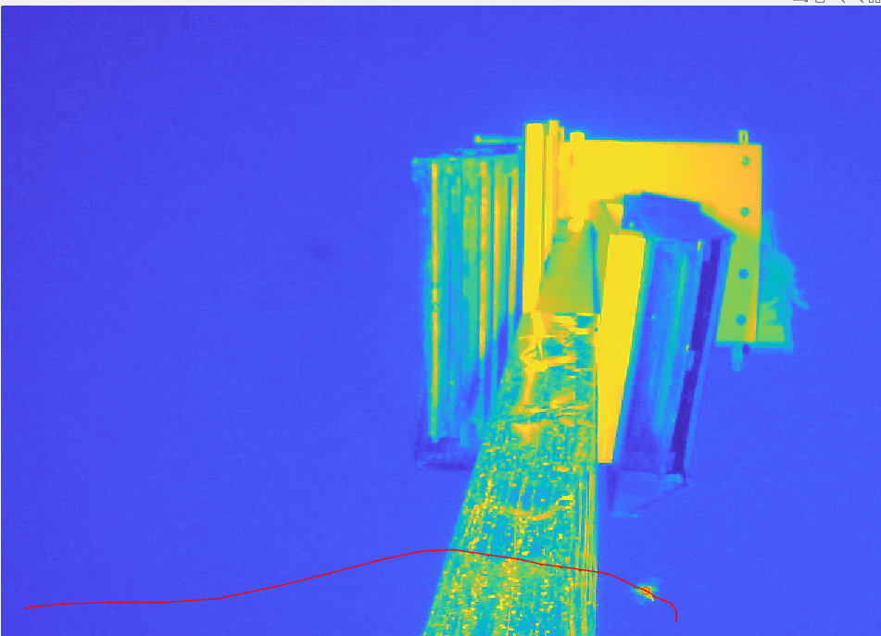
Insect Flyby
Notes:
This is an image from ThruTracker subtracts the static background from each frame and assigns a track to every object of a predetermined size and velocity. This slide demonstrates the problem with using IR illumination. Large insects and flying vegetation are illuminated so they are also tracked. This track clearly belongs to an insect. If we used a 1500-dollar thermal camera only bats and a few birds would be tracked but not insects. Our IR method is more labor intensive but much less expensive. With this method every track must be viewed and classified. ThruTracker also has automatic counting features that will help with this problem. That feature in the program is currently being fine tuned for the next version.

Slide 12
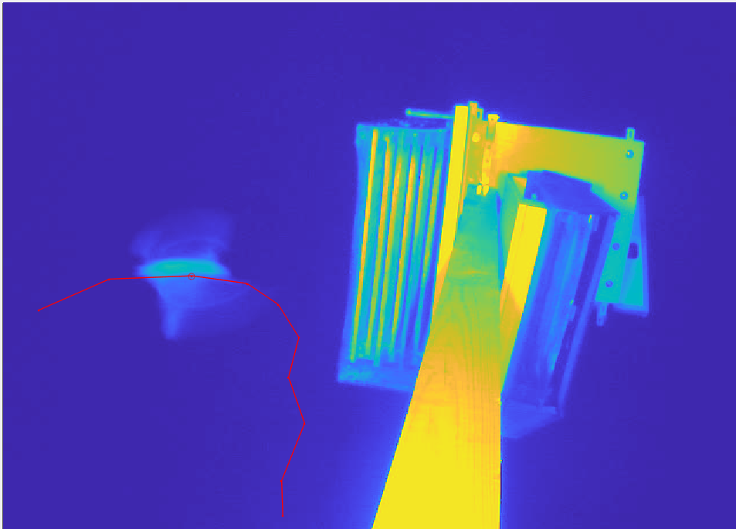
Bat Flyby
Notes:
This slide shows a bat track that can easily be classified as a flyby event because it never comes close to either bat house. This is all very interesting but we want to know which bats are actually egressing or returning to the bat house.

Slide 13
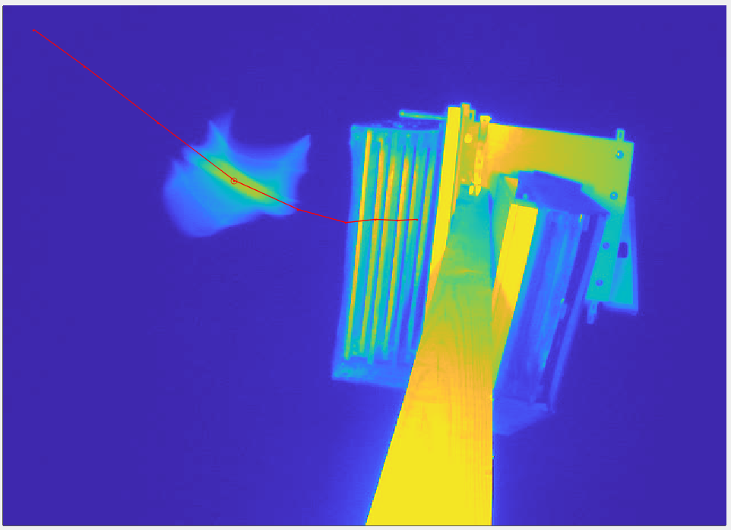
Bat Egressing
Notes:
This slide shows a bat egressing the larger bat house. ThruTracker also designates where the track starts and ends so it is easy to determine whether the bat is egressing or returning.

Slide 14
Net Outflow = Egress - Returns
NET OUTFLOW
Notes:
We subtract the bats returning from the bats egressing to get the Net Outflow number. This is sometimes called Residents since it appears that this number of bats were in the bat house that day. This slide shows the Net Outflow for each day throughout the active season with about 5% data losses. This recovering colony shows a maximum of some 300 bats at the end of June with wide day to day variations.

Slide 15
Egress Start Time (Min from sunset)
MINUTES FROM SUNSET
Notes:
This plot shows a systematic seasonal trend in the bat egress start times measured in minutes after sunset. The bats egress about 20 minutes after sunset in mid summer and about 35 minutes after sunset in spring and fall. This phenomenon has been previously reported in many species and in one species it’s reversed. One theory for little brown bats is that the pregnant and lactating females are much more stressed in summer and must egress earlier to attain the needed calories.

Slide 16
Comparing Net Outflow (blue) and Flyby Activity (orange)
NET OUTFLOWE
FLYBYS
Notes:
This plot shows an interesting bat behavior that occurred in June. The orange plot shows the number of bat flyby’s and the blue plot shows the Net Outflow. They were recorded for each day in June except for those 6 days lost due to a disk crash. It’s interesting that the flyby numbers rise to a peak and then fall around our estimate of Parturition and around Volency. If this phenomenon could be substantiated then it could be used to identify when Parturition and Volency occur.

Slide 17
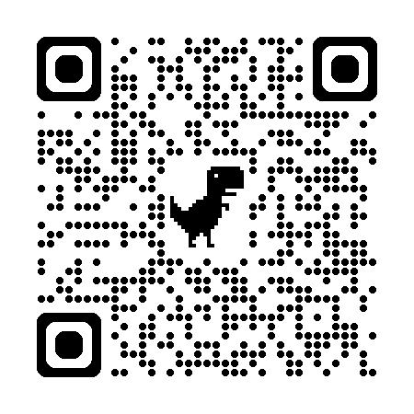
GitHub QR Code
Notes:
Finally As previously mentioned this project is registered public domain so the QR code above will go directly to the GitHub site. It contains all the computer code and a wiki with extensive construction notes and system test scripts. This slide deck is also located there. You can snap a picture of the QR Code above or I have a short handout summarizing the project with the QR Code.

